Slide 1
BCA MINI PROJECT · DEPARTMENT OF BCA
AI WeatherWise API
An AI-Powered Weather Information and Recommendation API
Kruthi
Divya Darshini
Team Leader & Project Developer
Video Editor & Voice-over
Hemalatha
Divya S
API Tester
Documentation

Slide 2
INTRODUCTION
Project Overview
AI WeatherWise API is a backend-based weather application that returns weather information for a requested city, enriched with AI-generated insights.
☁
⛅
✨
External Integration
OpenWeather API
Google AI Studio / Gemini
The project integrates external weather and AI services into one backend.
Used to obtain live, real-time weather data for any requested city.
Used for AI-based weather insights, summaries and recommendations.
☁︎
MongoDB Atlas
⚡
Thunder Client
Used for cloud database connectivity and storing application data.
APIs are tested end-to-end using Thunder Client inside VS Code.
AI WEATHERWISE API
2

Slide 3
THE CHALLENGE
Problem Statement
!
The Problem
✓
Our Solution
Weather APIs provide raw data that isn't always easy to understand.
An integrated solution combining weather data with AI-generated explanations and recommendations.
Users need weather information in a simple, meaningful format.
“AI WeatherWise API combines real-time weather data with AI processing to provide understandable weather summaries and recommendations.”
Traditional weather APIs give data without AI-based interpretation.
AI WEATHERWISE API
3

Slide 4
GOALS
Project Objectives
1
Develop a functional weather-based REST API
2
Retrieve weather information using OpenWeather API
3
Implement user registration and login
4
Connect the application with MongoDB Atlas
5
Integrate Gemini AI for weather summaries
6
Generate AI-based weather recommendations
7
Test API endpoints using Thunder Client
8
Upload the completed project to GitHub
AI WEATHERWISE API
4

Slide 5
TECH STACK
Technologies Used
⚙
▤
☁
⛅
Node.js
Express.js
MongoDB Atlas
OpenWeather API
Backend runtime
REST API development
Database
Weather data
✨
⌘
⚡
◈
Gemini AI
VS Code
Thunder Client
GitHub
AI processing
Development
API testing
Version control
AI WEATHERWISE API
5

Slide 6
HOW WE BUILT IT
Project Development Process
1
2
3
4
Downloaded source code from the Nan Mudhalvan team
Extracted project files into the WeatherWise API folder
Opened the project in Visual Studio Code
Configured the project and environment variables
5
6
7
8
Connected MongoDB Atlas
Obtained and configured the OpenWeather API key
Created the Gemini API key via Google AI Studio
Connected the required services to the backend
9
10
11
12
Installed dependencies using npm install
Started the application using npm run dev
Tested the APIs using Thunder Client
Uploaded the completed project to GitHub
AI WEATHERWISE API
6

Slide 7
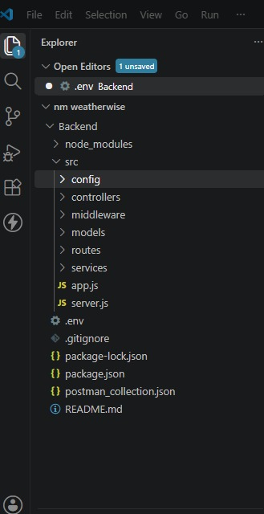
CODEBASE
Backend Project Structure
config
Database and configuration
controllers
Application logic
middleware
Authentication handling
models
Database models
routes
API endpoints
services
External API and AI service logic
app.js / server.js
App configuration and server execution
AI WEATHERWISE API
7

Slide 8
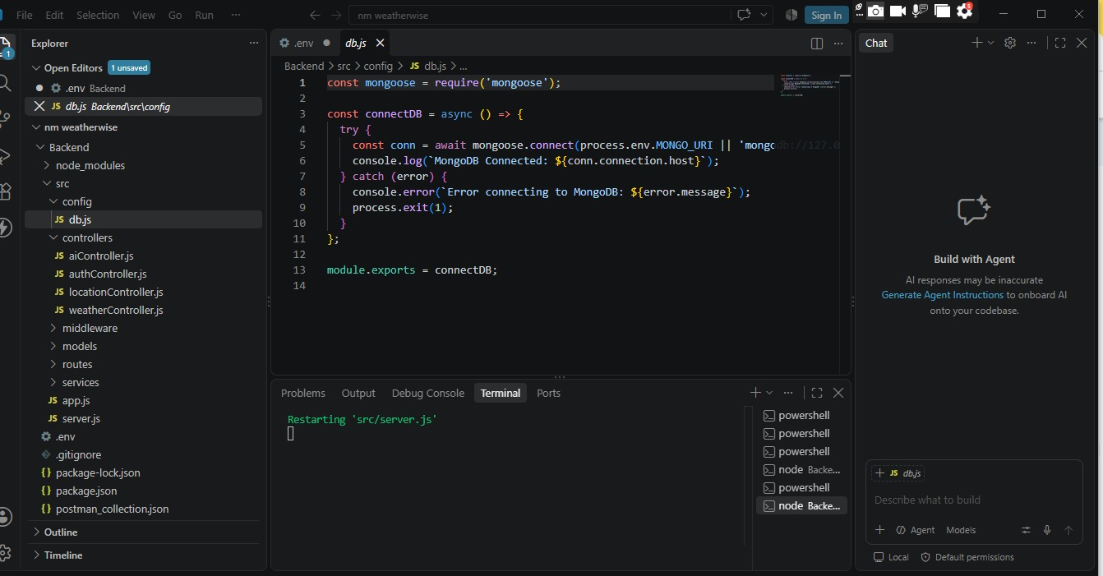
INTEGRATION
External Services Integration
1
MongoDB Atlas
Cloud database, connected via MongoDB/Mongoose, used for storing application data.
2
OpenWeather API
Provides temperature, humidity, wind speed and weather condition for any city.
3
Gemini AI (Google AI Studio)
Generates AI-based weather summaries and recommendations.
⚠ API keys, passwords and DB credentials are hidden from this presentation.
db.js — MongoDB connection configuration
AI WEATHERWISE API
8

Slide 9
RUNNING THE APP
Project Execution Steps
The project was executed using Visual Studio Code.
Open Project
Configure APIs
npm install
npm run dev
Server Started
API Testing
Commands Used
“After configuring the project, we installed all required dependencies using npm install and started the development server using npm run dev.”
Install dependencies
npm install
Start development server
npm run dev
AI WEATHERWISE API
9

Slide 10
ARCHITECTURE
System Architecture
USER / API TESTER
AI WEATHERWISE API
MongoDB Atlas
OpenWeather API
Gemini AI
JSON RESPONSE
Main Flow: Request > Backend > External Services > Processing > Response
AI WEATHERWISE API
10

Slide 11
VERIFICATION
API Testing Using Thunder Client
We used Thunder Client in Visual Studio Code to test every backend API.
1
2
3
4
5
Register API
Login API
City Weather API
Weather Summary API
AI Recommendation API
Testing Process
Send Request
>
Process Request
>
Receive Response
>
Verify Status & Data
All major API functions were tested individually using Thunder Client, and each response was verified for correct status codes and data.
AI WEATHERWISE API
11

Slide 12
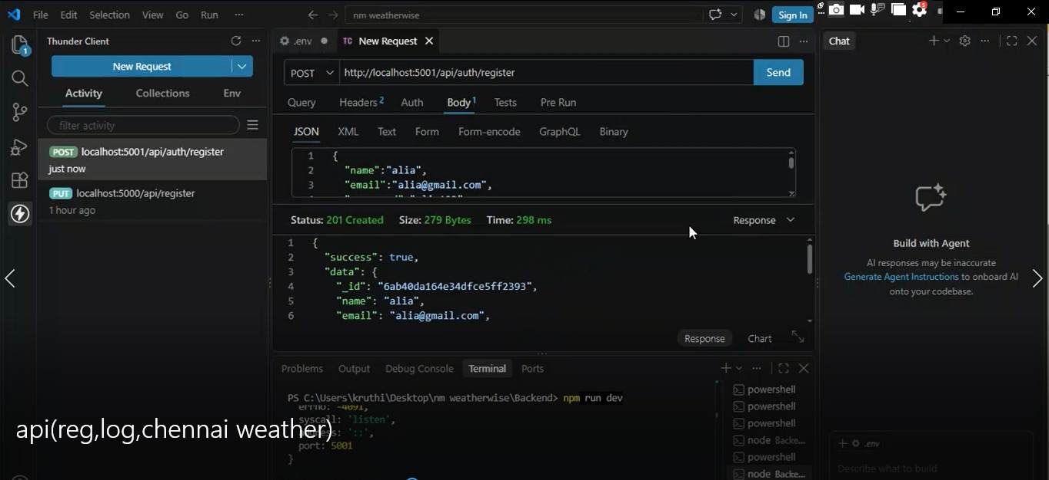
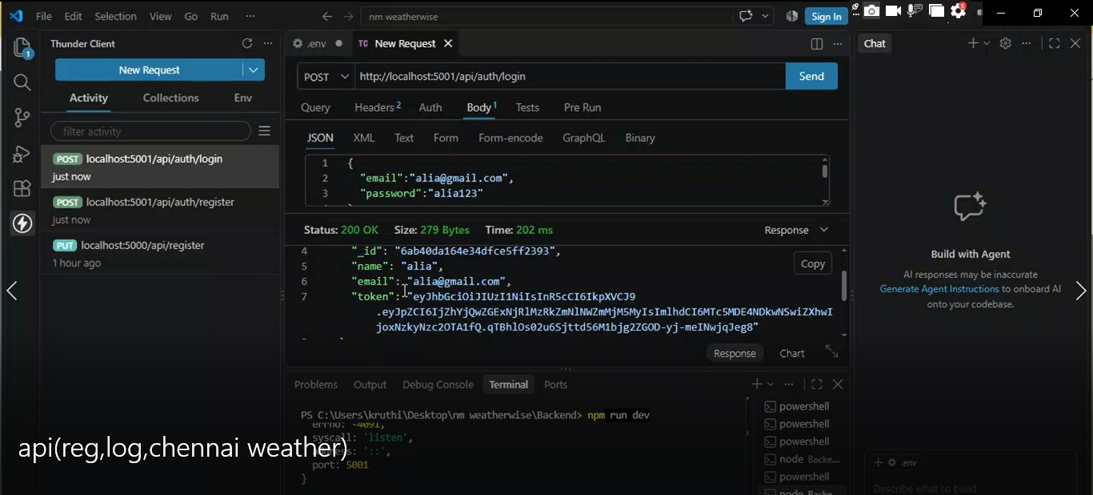
AUTHENTICATION
Register & Login API Testing
➕
Register API
✓
Login API
New user created via POST request — 201 Created
Credentials verified, auth token returned — 200 OK
AI WEATHERWISE API
12

Slide 13
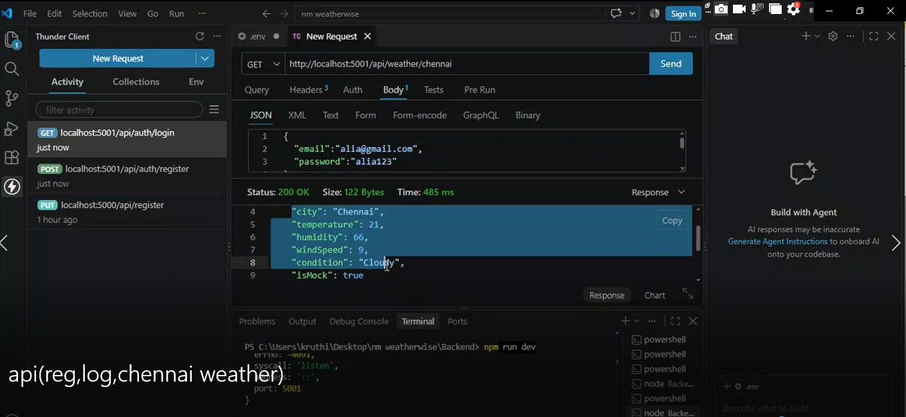
CORE FEATURE
City Weather API Testing
GET /api/weather/chennai
Response fields
City
Temperature
Humidity
Wind Speed
Weather Condition
HTTP 200 OK — structured weather data returned successfully for Chennai.
✓
AI WEATHERWISE API
13

Slide 14
AI LAYER
AI Weather Summary & Recommendation
Our project adds an AI layer on top of raw weather information.
Weather Summary
AI Recommendation
Converts weather data into an easy-to-understand summary, helping users grasp current conditions instantly.
Uses the available weather information to generate a practical, context-aware recommendation.
AI Workflow
Weather Data
>
Gemini AI Processing
>
Weather Summary
>
AI Recommendation
“The weather information is processed using Gemini AI and returned through our API as a clear summary and recommendation.”
AI WEATHERWISE API
14

Slide 15
END-TO-END
Complete Testing Workflow
1
Register
Testing Tool
2
Login
Thunder Client
3
Request City Weather
Result
4
The major API functions were tested individually and their responses were verified for correctness.
Receive Weather Data
5
Generate Weather Summary
6
Generate AI Recommendation
7
Verify Response
AI WEATHERWISE API
15

Slide 16
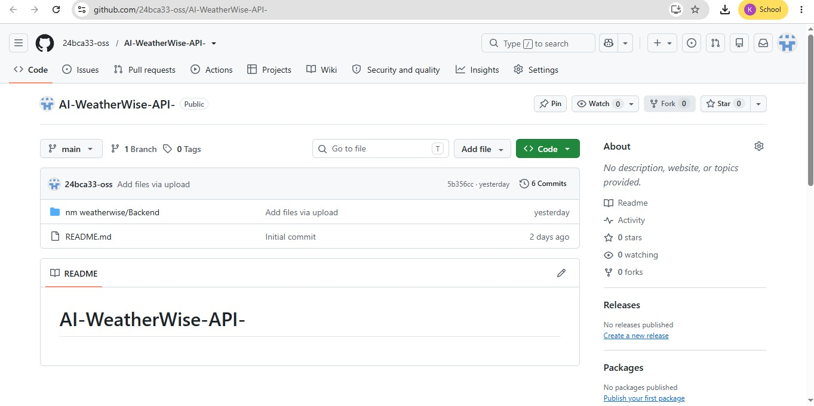
VERSION CONTROL
GitHub Integration
The project source code was uploaded to GitHub.
GitHub provides version control for the project.
The repository contains the backend source code and project files.
The repository can be used for sharing and future development.
⚠ .env and API keys are kept out of the public repository.
Repository: AI-WeatherWise-API-
AI WEATHERWISE API
16

Slide 17
OUTCOMES
Project Results
✓
Successfully set up and executed the backend project
✓
Successfully connected MongoDB Atlas
✓
Successfully integrated OpenWeather API
✓
Successfully integrated Gemini AI
✓
Successfully tested user registration and login
✓
Successfully retrieved city weather information
✓
Implemented AI-based weather summary and recommendation
✓
Tested API responses using Thunder Client
✓
Uploaded the completed project to GitHub
AI WEATHERWISE API
17

Slide 18
WHAT'S NEXT
Future Scope
🖥
📅
🔔
User-friendly web or mobile interface
Multi-day weather forecasts
Weather alerts and notifications
📍
✨
⚙
Automatic location-based weather
Improved AI recommendations with more context
Automated API testing
☁
Deployment to a cloud platform
AI WEATHERWISE API
18

Slide 19
WRAP UP
Conclusion
Backend API development
Weather API integration
Database connectivity
AI integration
Authentication
API testing
GitHub project management
“AI WeatherWise API combines weather information with AI-generated summaries and recommendations to provide meaningful and understandable weather insights.”
AI WEATHERWISE API
19

Slide 20
THANK YOU
Questions & Discussion
AI WEATHERWISE API · DEPARTMENT OF BCA
Kruthi · Divya Darshini · Hemalatha · Divya S

